Slide 1
PEACE TAILORING ONLINE SHOPPING STORE
By Sylvia Yvonne Onserio
Reg No : 17s03adit018
Supervisor : Ambrose Njeru

Slide 2
Introduction
This project sets it focus on the online shopping clothing stores
People were in the past constrained to going to the shops and markets to make a purchase, a tedious and time consuming process.
Online stores have revolutionized the way shoppers make purchases enabling people to carry out shopping at the comfort of their homes.
The stores therefore have a list of chosen designers and transporters who handles the cloth production and shipping services respectively.

Slide 3
Research Problem
Despite online cloth shopping stores being quite essential in giving the best shopping experience there's still a lot of gaps that is left unattended to.
The stores lack variety due to only relying on a fixed number of designers for their cloth merchandise, locking out the rest of the talented designers and limiting them only to the shoppers in their locality.
There is lack of personal touch and originality in the clothed due relaxed competition in the online market hence forcing the shopper to settle for only standard quality clothing.
The shipping services are also under-used

Slide 4
Proposed Solution
Providing a platform that any designer can easily sign up and sell their produce to a wider market without restrictions.
The system should also enable transporters to carry offer out shipping services at a cost.
Enable the shoppers to get access to a wider list of designers hence getting more variety of the product hence ensuring high quality of clothes of purchased and therefore better customer satisfaction.

Slide 5
Research Objectives
A research on current online stores was carried out with an aim of finding out the following:
How the current online stores work
What is the business model that are used
Who are the contributing parties that make online shopping
What are the major is weaknesses that exist
How can the systems be made more efficient to improve customer experience.

Slide 6
Research Questions
The research on online and traditional shopping stores was carried out with the following stores in mind:
How does online shopping work in general stores.
What are the various business models that are placed in the working of the online stores.
Who are the specific group of individuals that make up the structure of the online shopping stores.
What are the major issues facing the current list of stores and how they can be addressed.
How can the shopping experience be enhanced and by what additional feature.

Slide 7
Literature Review
During my research I was able to come up with detailed information on how the online stores worked and their business models that they.
The information on the online shopping stores also enabled the determining the various parties involved in online shopping and their individual roles in the system.
While focusing on online shopping stores which dealt in clothing I was also able to carry out a review on the following shopping stores
Mimi Kenya Online Shopping stores
Jumia online shopping Store
Mama Mike’s Online Shopping store

Slide 8
Methodology
My research mainly employed the use of quantitative design techniques in order to gather data about people and their experience and expectations they have while shopping online for clothes.
My main quantitative tool of research was the use of a questionnaire.
A questionnaire was developed and distributed among random individuals within and away from the campus environment with an aim of collecting data on their feedback concerning online clothing stores.
The data was then analyzed and conclusions drawn from them on the peoples opinion on online shopping and the type of improvements that they hoped to see takes place.

Slide 9
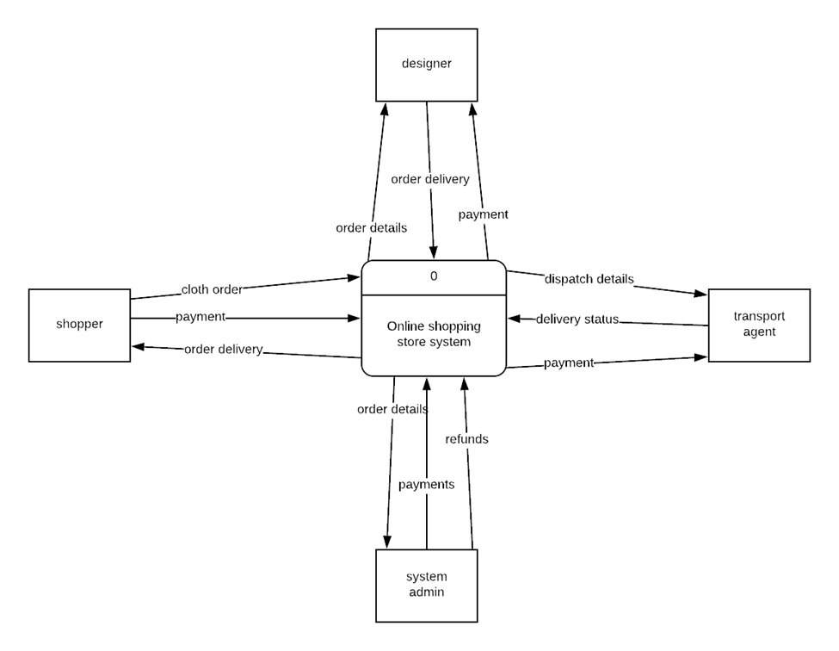
Design
Context Diagram

Slide 10
Methodology (cont…)
Apart from the questionnaires, online articles served a great deal in offering information concerning the topic at hand.
A visit to the websites that dealt with the same business was also of great use to the research because it exposed me to the various business models used by the different stores to achieve their purpose.

Slide 11
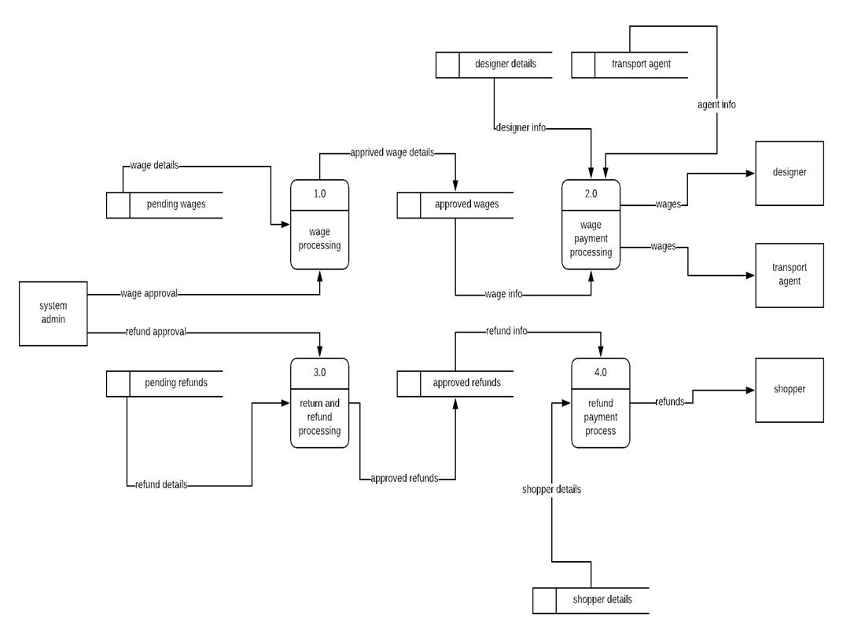
Design(cont…)
Level 0 DFD

Slide 12
Project Work Plan
The Gantt chart below gives the project activity plan.
Task | Task name | Planned hours | Start date | Finish date | September |  |  |  | October |  |  |  | November
1 | Problem definition | 10 | 10/09/2018 | 14/09/2018
2 | Requirement analysis | 10 | 17/09/2018 | 21/09/2018
3 | System design | 15 | 24/09/2018 | 3/10/2018
4 | System coding | 80 | 8/10/2018 | 23/11/2018
5 | Testing and debugging | 10 | 26/11/2018 | 30/11/2018
6 | Deployment and maintenance | 6 | 30/11/2018 | 3/12/2018
7 | Documentation | 120 | 17/09/2018 | 30/11/2018

Slide 13
Conclusions
This project will at the end contribute towards enhancing shopper experience while shopping online for clothes with ease and from a wide network of designers from all over the country.
Income earning opportunities will also be created for the designers and the transporters within, hence bettering lives for all the parties involved while contributing to economic development.

Slide 14
The End
…Thank You For Your Time…

